Slide 1

Media for Thought
A Samuel Pottinger
Stat 198: IDSV
April 14, 2025

Slide 2
Today
> Intro
Thinkers
Group activity
Wrap up
Final project

Slide 3
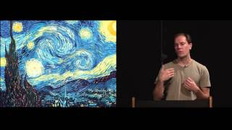
Stop drawing dead fish
Notes:
https://vimeo.com/64895205

Slide 4
Today
Intro
> Thinkers
Group activity
Wrap up
Final project

Slide 5
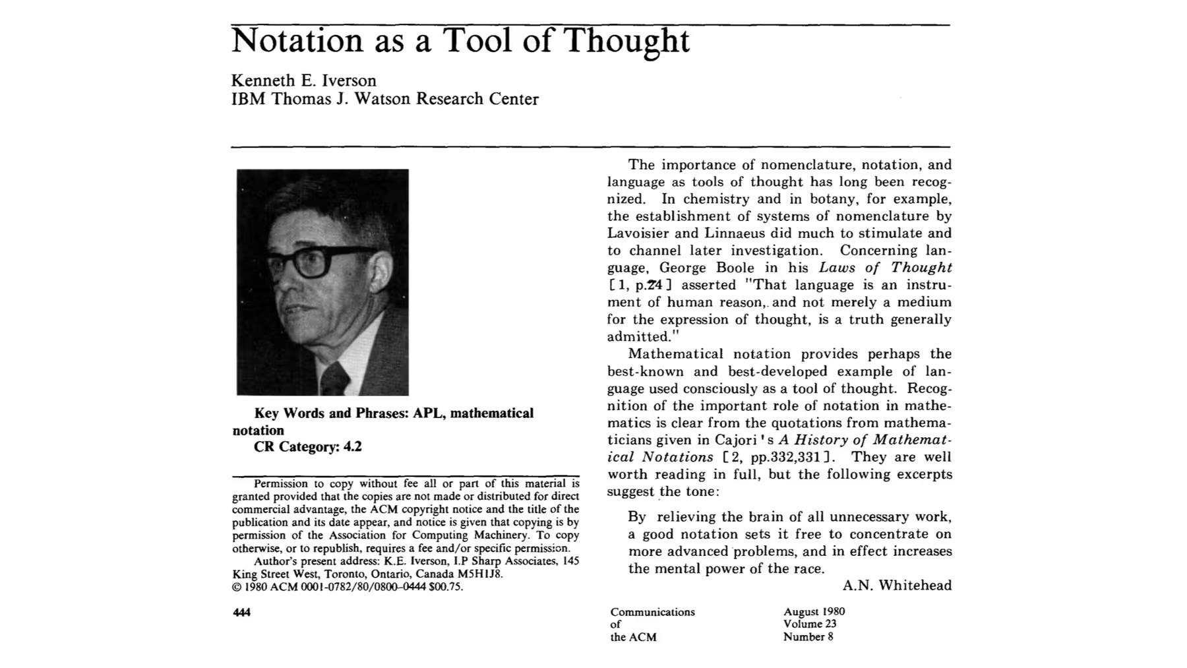
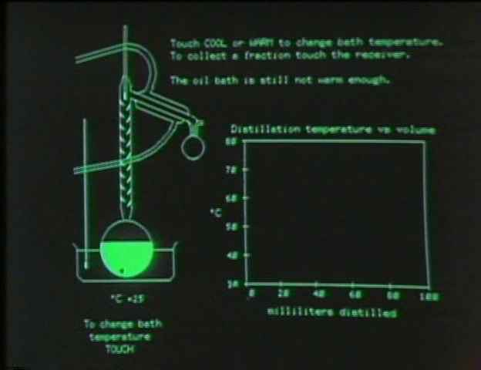
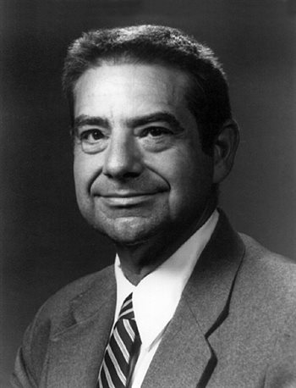
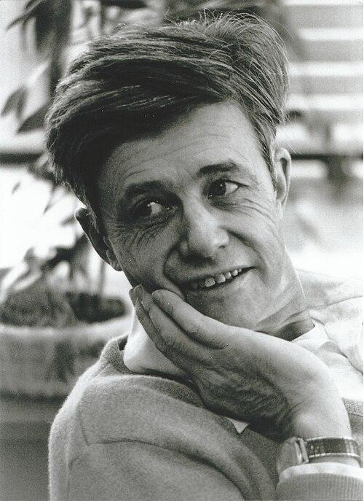
Some ingredients - Don Blitzer and Kenneth Iverson

Slide 6
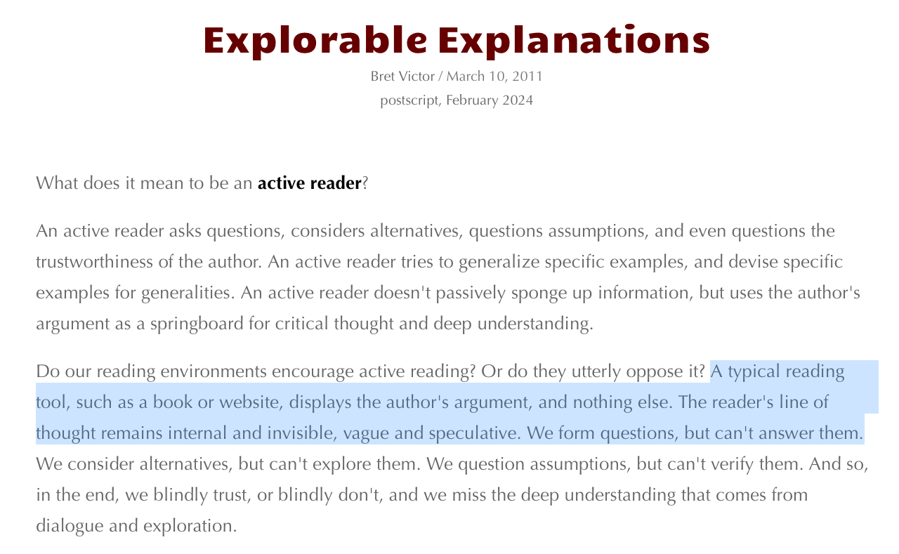
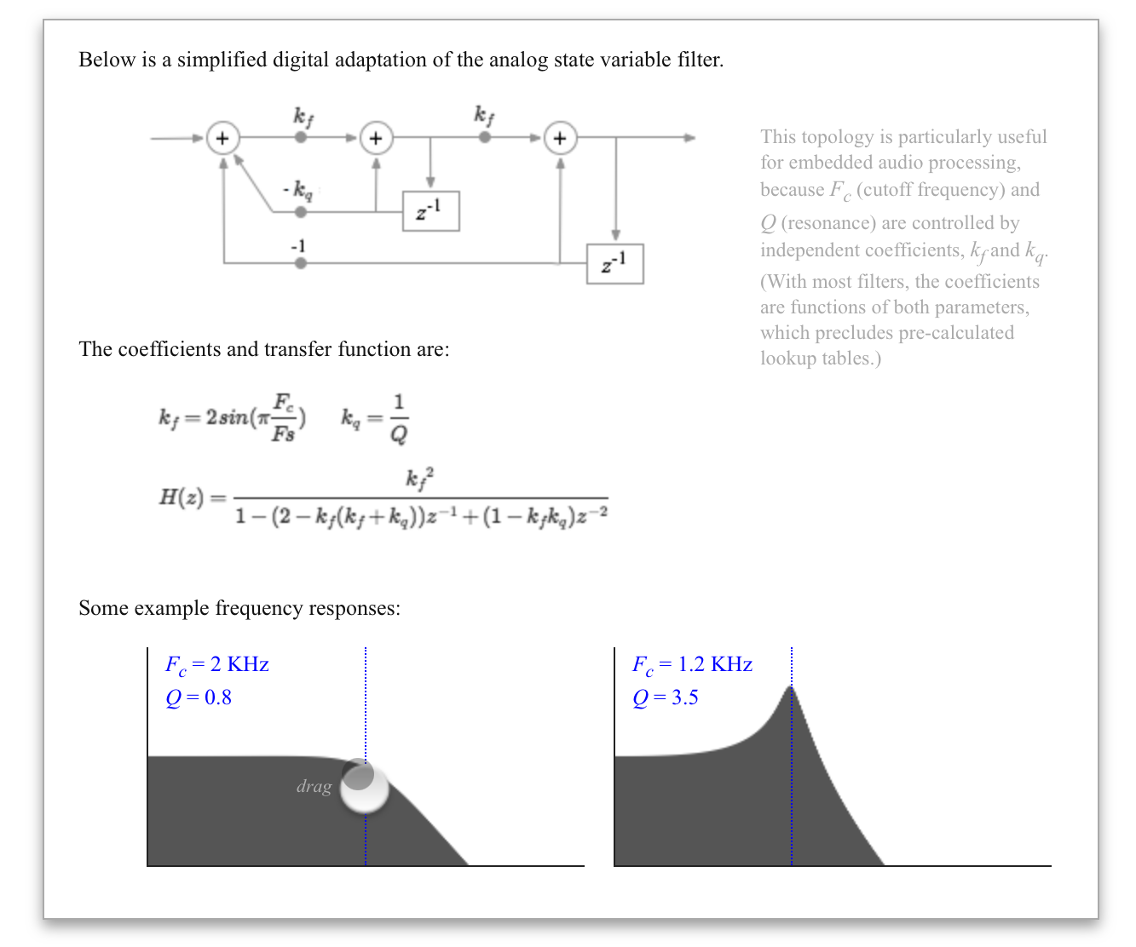
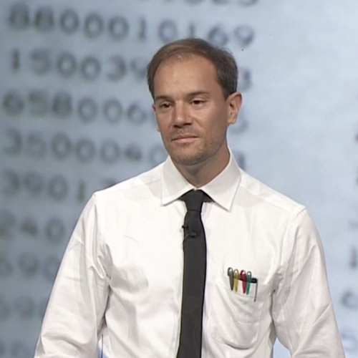
Some ingredients - Bret Victor
Notes:
https://en.wikipedia.org/wiki/Bret_Victor#/media/File:Bret_Victor.png
https://worrydream.com/ExplorableExplanations/

Slide 7
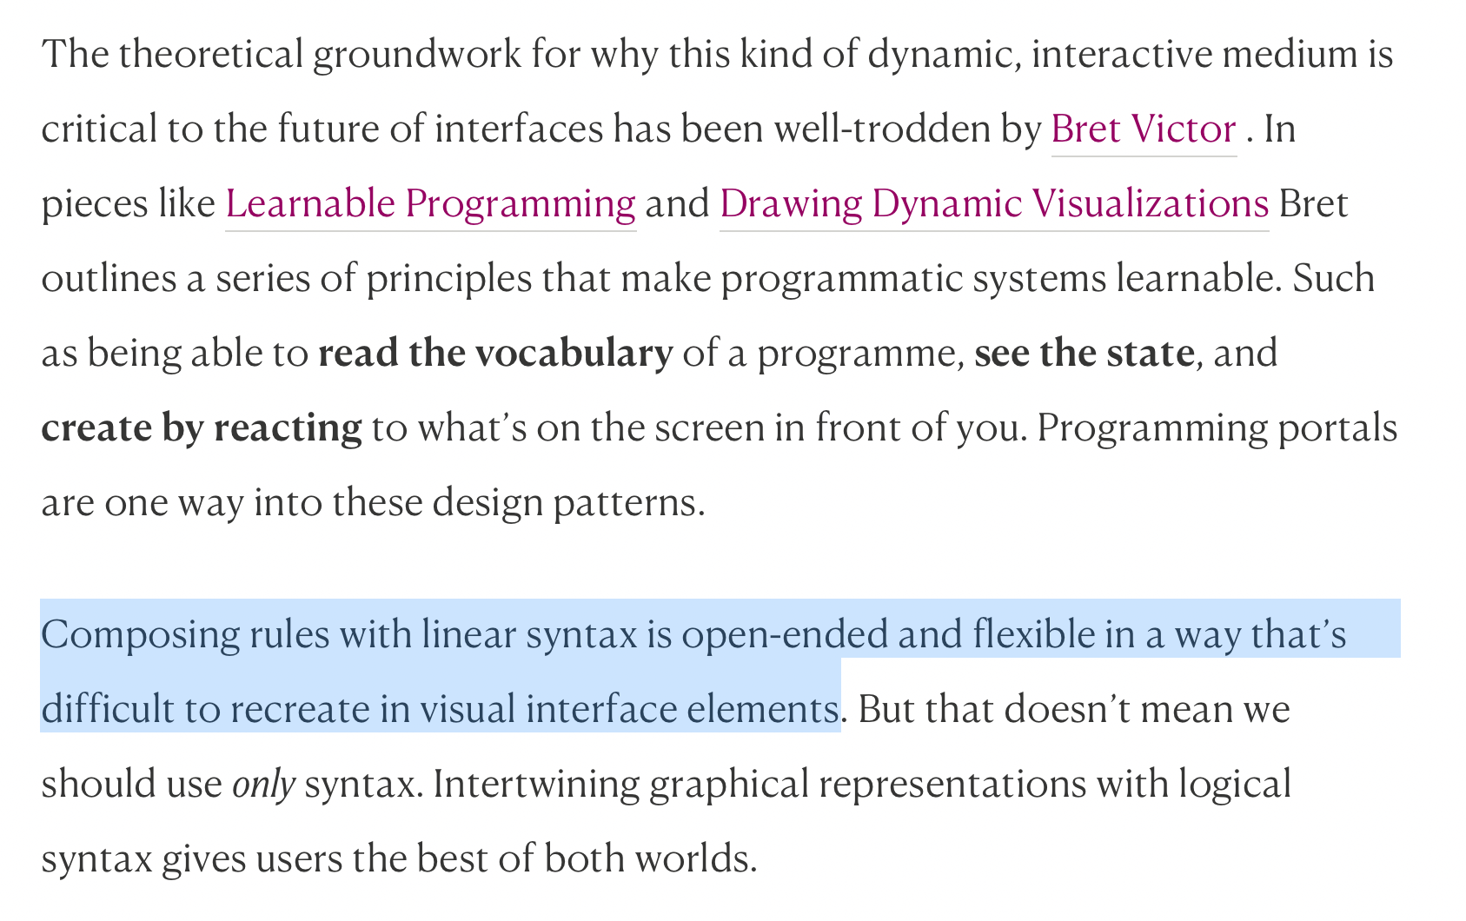
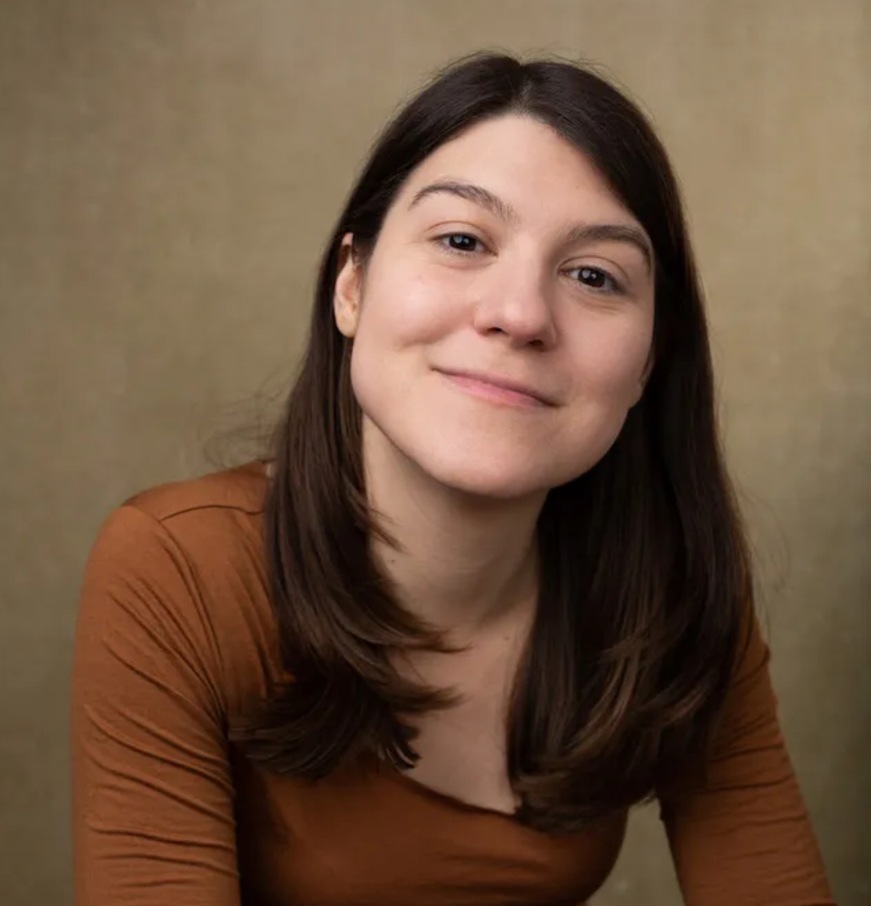
Some ingredients - Maggie Appleton
Notes:
https://maggieappleton.com/programming-portals/

Slide 8
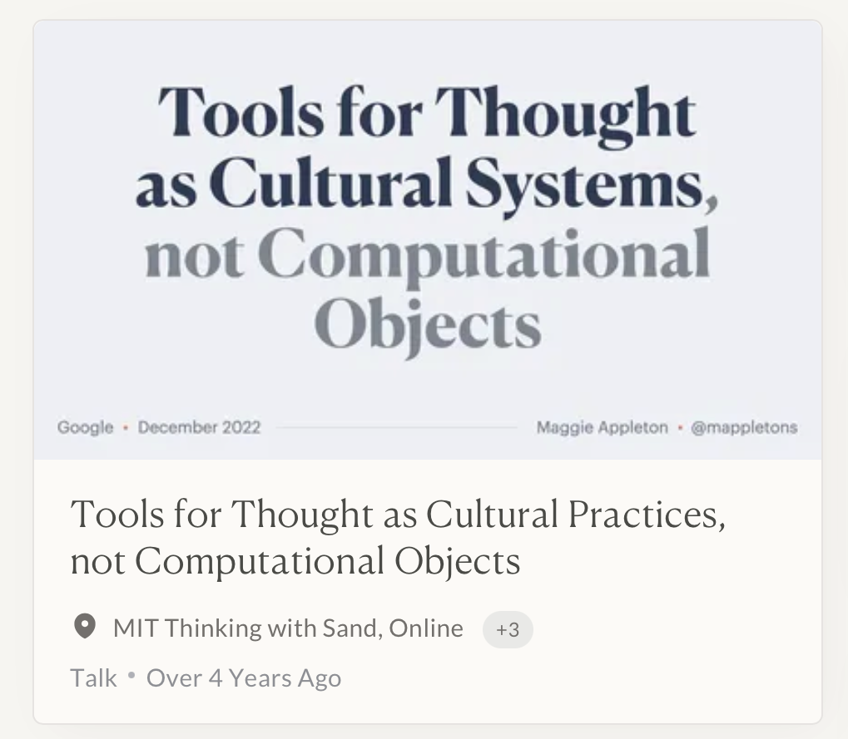
Some ingredients - Maggie Appleton
Notes:
https://maggieappleton.com/tools-thought-talk

Slide 9
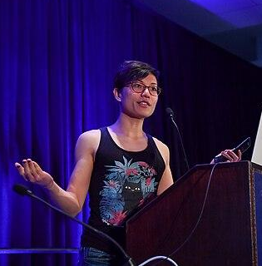
Some ingredients - Nicky Case
Parable of the Polygons
Evolution of Trust
Explorable Explanations
Notes:
https://en.wikipedia.org/wiki/Nicky_Case

Slide 10
Today
Intro
Thinkers
> Group activity
Wrap up
Final project

Slide 11

Group activity: explorables
https://explorabl.es
Find an explorable explanation
Identify the user loop
What does that user loop add that a static equivalent would not have?
Notes:
https://explorabl.es/

Slide 12
Today
Intro
Thinkers
Group activity
> Wrap up
Final project

Slide 13
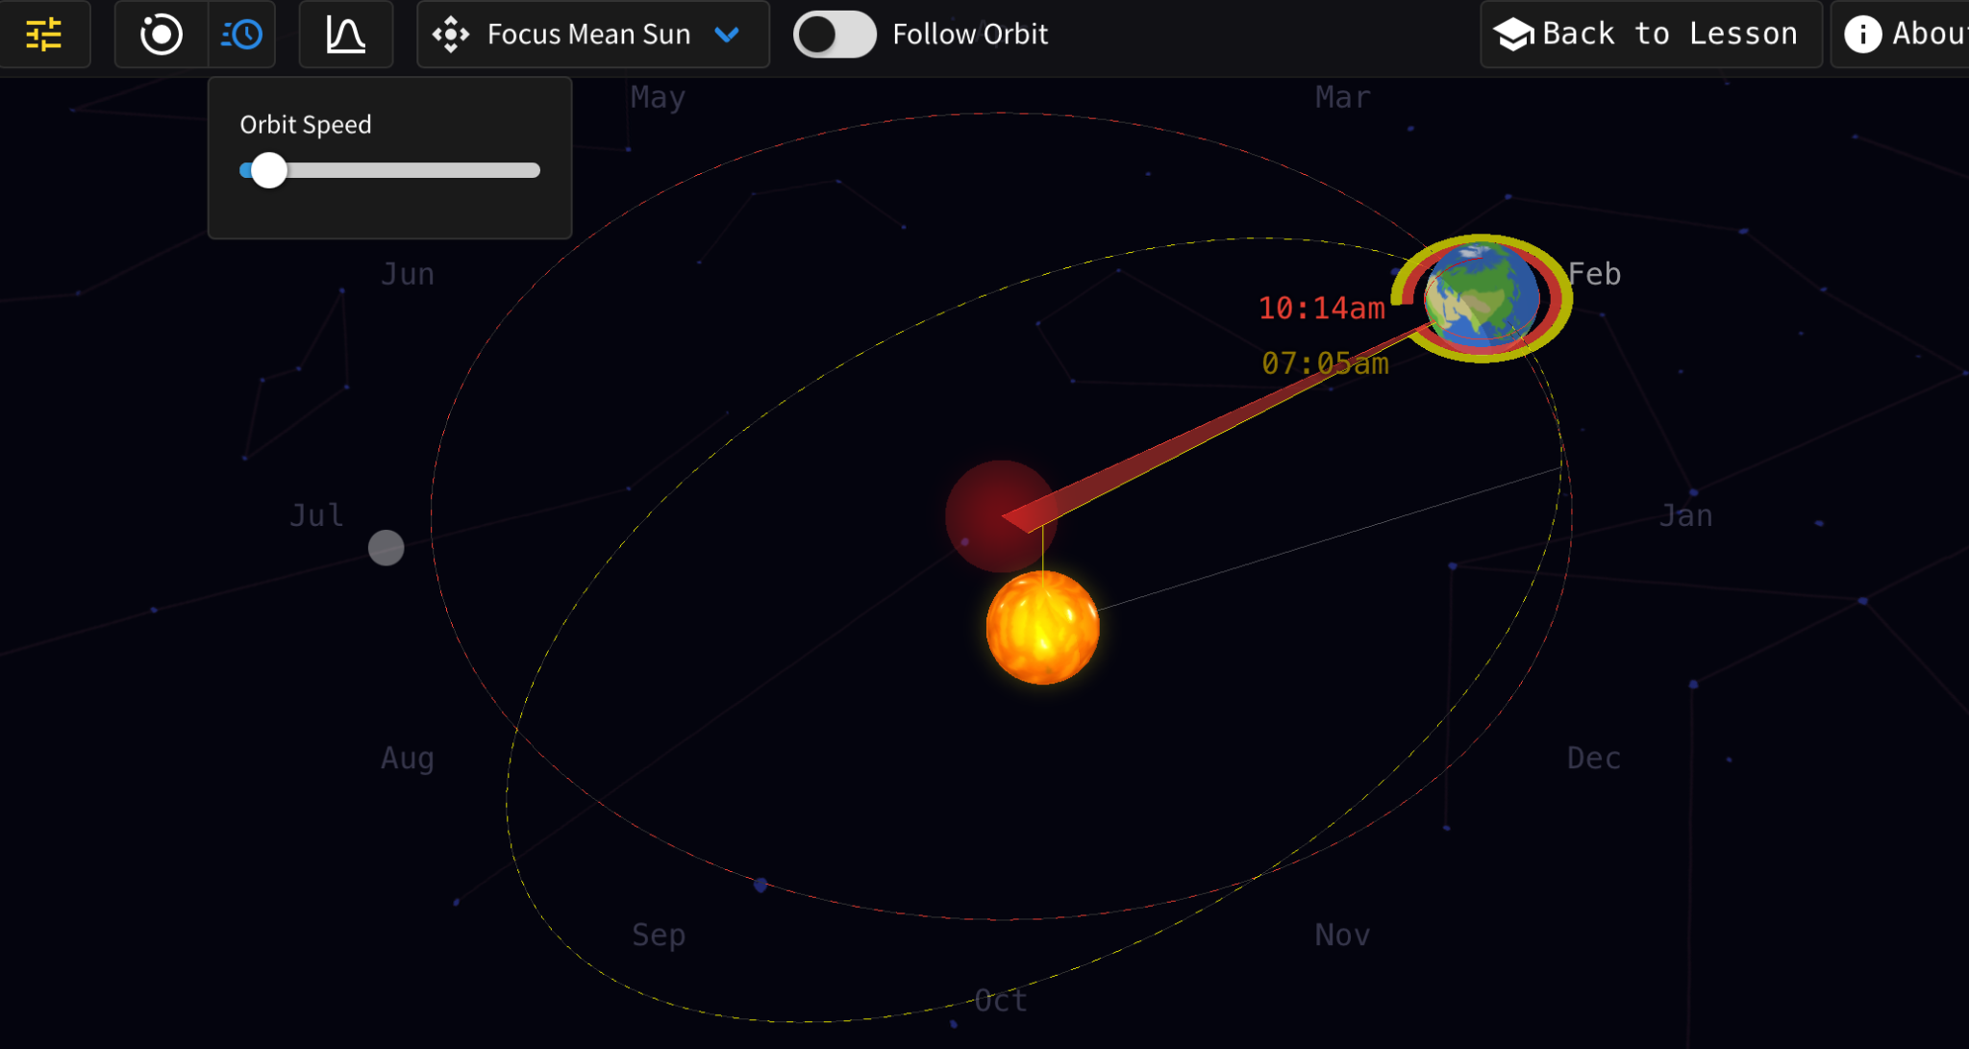
Possibility space and diegetic elements
Diegetic elements
Possibility space
Notes:
https://labs.minutelabs.io/what-is-a-day/

Slide 14
How to think about media for thought
Assume the user to be a co-creator of meaning.
Create space for the user to explore outside of your narrative.
Offer meaningful controls but within a clear possibility space with clear user loops.

Slide 15
Today
Intro
Thinkers
Group activity
Wrap up
> Final project

Slide 16
Final project timeline
April 11: Final assigned.
May 1: Last day to get rough draft feedback.
May 2: Accommodations due.
May 14: Final projects due at 7pm on Zulip
May 14: Live presentations
May 16: Zoom presentation alternative

Slide 17
Final project objective
Above all else, this should be an interactive visualization you are proud of. All else is secondary.
Guidelines on Zulip but at least one user action and at least 6 variables though subject to exceptions (May 2 due date).
Pre-approved datasets in the course manual, reach out by April 21 if you have others.

Slide 18
Final project logistics
Live presentations: We will have three groups, one group will present and the other two provide feedback in expo-style. Only feedback that influences grade is from instructor. Friends and family welcome (may have 1 group be for those without preference or opt-out).
Zoom alternative: Direct presentations (not expo) with peer feedback due to Zoom constraints.

Slide 19
Appendix

Slide 20
Works cited
A. Shatov, "White Digital Device at 12 00," Unsplash, 2021. Available: https://unsplash.com/photos/white-digital-device-at-12-00-DHl49oyrn7Y
B. Victor, "Stop Drawing Dead Fish," SIGGRAPH, 2012. Available: https://vimeo.com/64895205
Wikipedia Contributors, "PLATO," Wikimedia Foundation, 2025. Available: https://en.wikipedia.org/wiki/PLATO_(computer_system)
Kenneth E. Iverson Estates, "Kenneth Eugene Iverson (17 December 1920 – 19 October 2004)," Wikimedia Foundation, 2017. Available: https://en.wikipedia.org/wiki/Kenneth_E._Iverson#/media/File:Kei_younger.jpg
The Grainger College of Engineering, "Donald L. Bitzer," University of Illinois Urbana-Champaign, 2004. Available: https://grainger.illinois.edu/alumni/distinguished/Donald-Bitzer
K. Iverson, "Notation as a Tool of Thought," ACM, 1980. doi: 10.1145/358896.358899
B. Victor, "Bret Victor," Wikimedia Foundation, 2013. Available: https://en.wikipedia.org/wiki/Bret_Victor#/media/File:Bret_Victor.png
B. Victor, "Explorable Explanations," Bret Victor, 2011. Available: https://worrydream.com/ExplorableExplanations/
M. Appleton, "Programming Portals," Maggie Appleton, 2022. Available: https://maggieappleton.com/programming-portals/
M. Appleton, "Tools for Thought as Cultural Practices, not Computational Objects," Maggie Appleton, 2025. Available: https://maggieappleton.com/tools-thought-talk
M. Appleton, "Maggie Appleton," Maggie Appleton. Available: https://maggieappleton.com/about
GDC, "Nicky Case 2019 Crop Photo," Wikimedia Foundation, 2025. Available: https://en.wikipedia.org/wiki/Nicky_Case#/media/File:Nicky_Case_-_Game_Developers_Conference_2019_Crop.png

Slide 21


